Slide 1
BODY PARTS

Slide 2
A HEAD

Slide 3
EYES

Slide 4
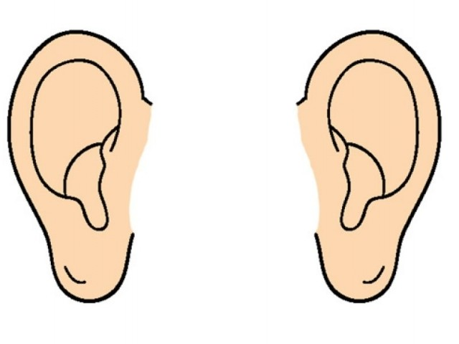
EARS

Slide 5
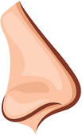
A NOSE

Slide 6
A MOUTH

Slide 7
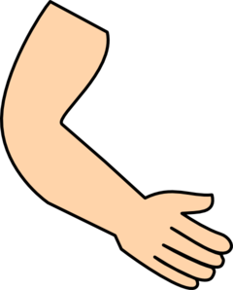
ARMS

Slide 8
NOSES

Slide 9
LEGS

Slide 10
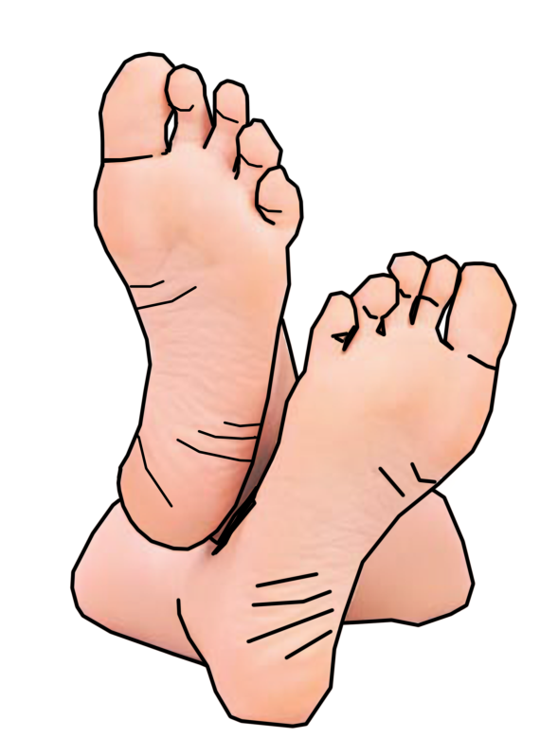
FEET

Slide 11
A LEG

Slide 12
A FOOT

Slide 13
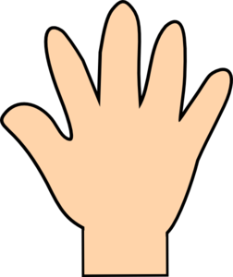
HANDS

Slide 14
AN EAR

Slide 15
AN ARM

Slide 16
SHOULDERS

Slide 17
AN EYE

Slide 18
HEADS

